Slide 1
Predicting Temperature Changes in the U.S.

Slide 2
Overview and problem statement
We are interested in setting up a machine learning model to predict average temperatures across the U.S.
We would like to measure the performance of various supervised machine learning algorithms.
We will examine the average land and surface temperature from 1850 until 2020.
Notes:
We are framing this problem in terms of a clear business need. And asking the question, what is this analysis actually going to do for our business, right? Remember, it’s our world, the statistics are just living in it!

Slide 3
Recent Temperature Changes
In 1970, the average land and ocean temperature was 59.6 degrees Fahrenheit.
In 2015, the average temperature increased to 60.9 degrees Fahrenheit.
Global temperature is projected to warm by about 1.5 degrees by 2050 and 3.6 – 7.2 degrees by 2100.
Source: Berkeley Earth Climate Data
Notes:
Moving from research question to some kind of hypothesis -- you want to use logic, theory and prior empirical evidence to move toward some hypotheses you can test. This is why domain expertise cannot be overlooked among data scientists.

Slide 4
Data analyzed
Average Land and Ocean Temperatures in the U.S. between 1850 and 1915.
Data includes average land temperature, minimum land temperature, and the maximum land temperature.
All temperature data has uncertainty boundaries.
Raw data available here
Source: Berkeley Earth Climate Data
Notes:
Set the stage a bit -- where is the data coming from? Be as transparent as possible. Explain to the audience what you were thinking about data collection in terms of what data was necessary and how that in turn shaped your thinking on the kind of analysis that would be most appropriate given the objective.

Slide 5
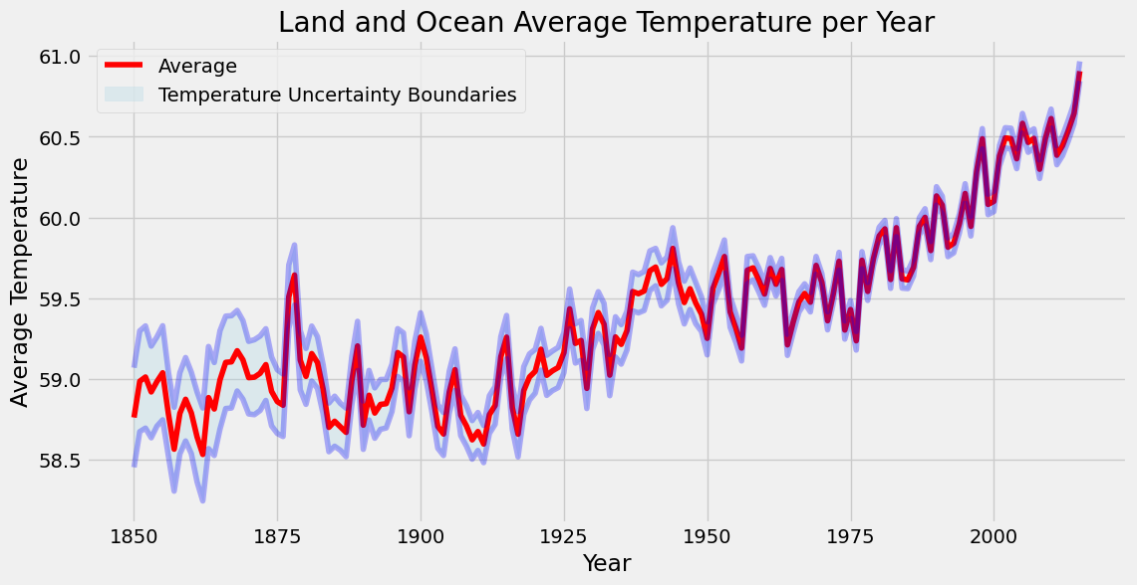
Time Series Plot 1

Slide 6
Box Plot 1

Slide 7
Machine Learning Model (Supervised Regression)
Feature variables:
Land Average Temperature (continuous)
Land Minimum Temperature (continuous)
Land Maximum Temperature (continuous)
Target variable:
Land and Ocean Average Temperature (continuous)
Notes:
We are framing this problem in terms of a clear business need. And asking the question, what is this analysis actually going to do for our business, right? Remember, it’s our world, the statistics are just living in it!

Slide 12
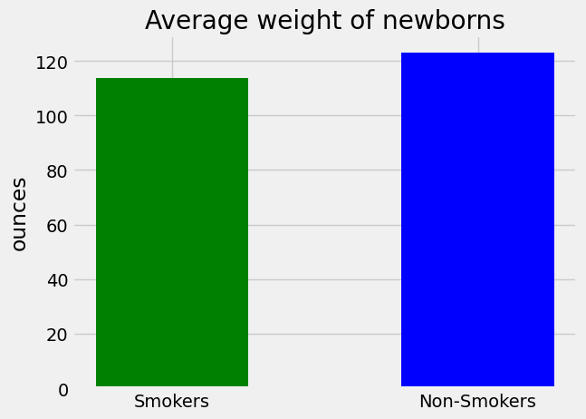
Statistically significant difference between mothers who smoke and non-smokers:
With 95% confidence, the average weight of newborns from non-smokers is between 7 and 11 ounces higher than newborns from smokers.
The average weight of newborns from smokers is 114 ounces while the average weight of non-smokers is 123 ounces.
Notes:
A statistical method is not a story, but we can tell a story from the statistics. For example, using confidence intervals we can put into dollars what we think would happen if we make some business move, given the data that we have.
The words “t-test,” “normality,” “independent samples” etc did not come up at all in this explanation! Although someone who does know about this stuff can still have confidence in the results with the way you have laid out the story and the quantifiable results.

Slide 13
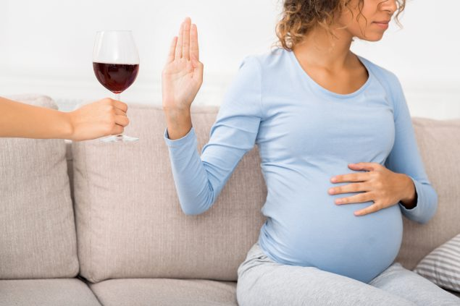
Other factors influencing birth weight?
Alcohol consumption and the total length of the pregnancy.
A/B test differences on different U.S. datasets in the 2000s.
Notes:
https://unsplash.com/photos/OX_en7CXMj4
Then we want to move to recommendations, what is the call to action? What should your audience do now that they know what you have told them?

Slide 14
Recommendations to mothers
Limit or stop smoking while pregnant to increase health of newborn.
Get regular prenatal checkups.
Eat healthy and stay physically active.
Notes:
Set the stage a bit -- where is the data coming from? Be as transparent as possible. Explain to the audience what you were thinking about data collection in terms of what data was necessary and how that in turn shaped your thinking on the kind of analysis that would be most appropriate given the objective.

Slide 15
Questions?

Slide 16
Thank You

